Slide 1

Intangible heritage policies and institutions
Unit 26 Presentation

Slide 2
In this presentation
Legal and institutional frameworks
Frameworks: what for?
Local frameworks
National frameworks
International frameworks
Case studies

Slide 3
Legal and institutional frameworks
Local frameworks, e.g.
Provincial laws / regulations
Municipal regulations
Local & community-based organizations
National frameworks, e.g.:
Constitution or Bill of Rights
Cultural policy
Networks
ICH policy
IPR regimes
Universities, archives, museums
International frameworks, e.g.:
ICH Convention and others
Human rights instruments
IPR guidance (WIPO)
Regional agreements
International NGOs, C2Cs

Slide 4
Frameworks: what for?
Safeguarding
Inventorying
Reporting
Capacity-building
Documentation and Research
Awareness-raising
Access
Community participation
Protecting community interests
Networking, coordinating

Slide 5
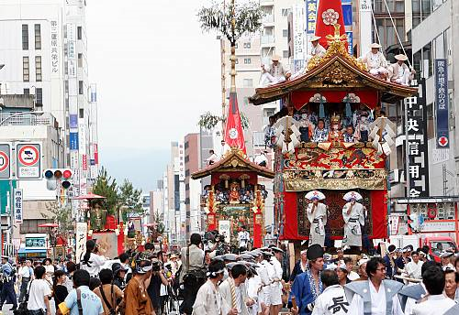
The Yamahoko float ceremony, Kyoto Gion festival, Japan

Slide 6
Yamahoko-related frameworks
Kyoto prefectural inventory, municipal support for procession and community associations
National legislation and inventory for ICH in Japan; National research institutions; budget allocations
Intangible Heritage Convention obliges Japan to safeguard the procession and report on it

Slide 7

LOCAl frameworks

Slide 8
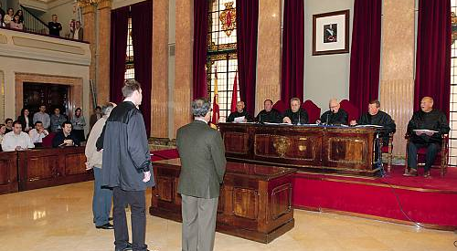
Irrigators’ Tribunals (Spain)
The Council of Good Men of Murcia © Servicio Patrimonio Historico de la Region de Murcia
Notes:
http://www.unesco.org/culture/ich/index.php?lg=en&pg=00011&RL=00171

Slide 9
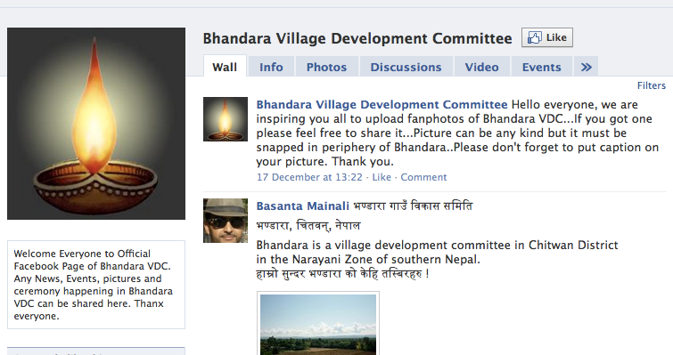
Village Development Committees (Nepal)
Notes:
http://www.facebook.com/pages/Bhandara-Village-Development-Committee/136611956377609#!/pages/Bhandara-Village-Development-Committee/136611956377609?v=wall

Slide 10
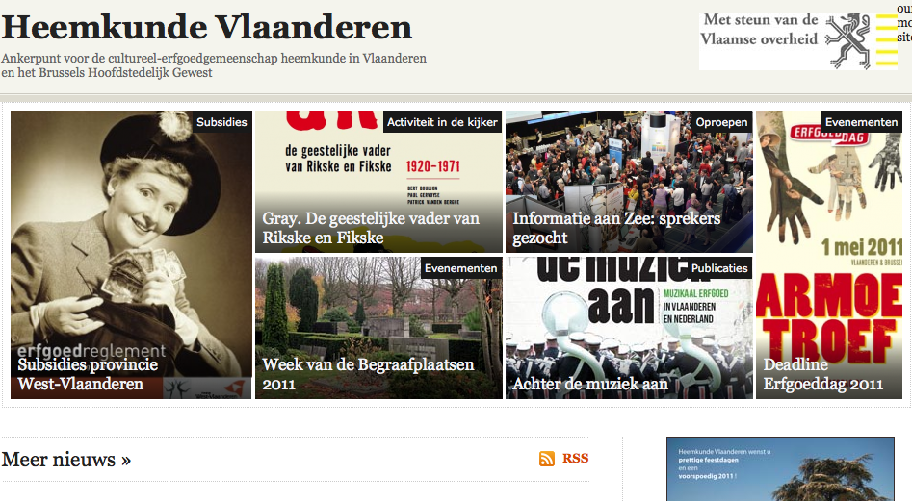
Heemkunde Vlaanderen (Belgium)
Notes:
http://www.heemkunde-vlaanderen.be/

Slide 11
Local (municipal, provincial) frameworks can best …
Respond to the needs of local communities and their ICH
Integrate ICH safeguarding with health, education and other concerns

Slide 12

National frameworks

Slide 13
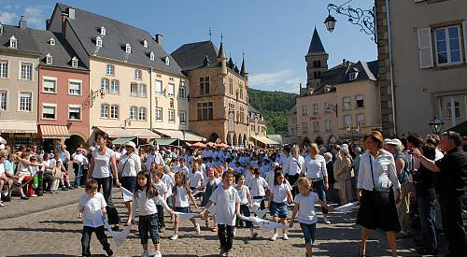
Hopping Procession (Luxembourg)
© Peuky Barone-Wagner
Notes:
http://www.unesco.org/culture/ich/index.php?lg=en&pg=00011&RL=00392

Slide 14
National frameworks
Support States Parties’ obligations to identify and define, inventory and safeguard the ICH in their territory
Some may be specifically for ICH safeguarding, others may have a broader remit
Some may already exist in the country, others may be created after ratification of the Convention

Slide 15
South Africa’s legislative framework for ICH
Cultural policy
Indigenous knowledge policy
Traditional medicine legislation
ICH policy
Intellectual Property laws
Heritage legislation
Language Policy
Provincial and local policy and legislation
Bioprospecting legislation
Constitution

Slide 16
Legal frameworks and policies for …
Safeguarding
Promotion
Integration into planning programmes
Access (ethics)
Awareness (ethics)
Recognition, respect and enhancement

Slide 17





Trademarks

Slide 18
Institutional frameworks for …
Identifying, defining, inventorying and documenting the ICH
Implementing concrete safeguarding activities
Conducting training in the management and appropriate transmission of ICH
Undertaking and/or coordinating ICH-related scientific, technical, legal, economic and other studies
Raising awareness about the value and diversity of the ICH
Ensuring community participation and consent in all activities concerning their ICH

Slide 19

International frameworks

Slide 20
International Frameworks
Human rights instruments
ICH Convention
Intellectual property agreements
Other international instruments, guidelines and ethics codes
International NGOs, research centres etc
Safeguarding ICH

Slide 21
International legal instruments
Human rights instruments
World Heritage Convention
Intellectual property agreements
Convention on Biological Diversity

Slide 22
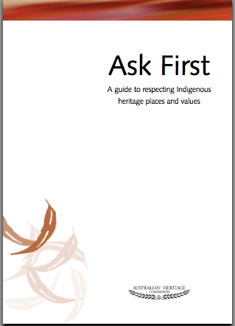
Guidelines and codes of ethics

